Slide 1
Altered renal function and anesthetic agents
MERON A.
JUNE, 2024

Slide 2
Introduction
Multiple medications used in the perioperative period can have adverse affects on renal function.
Most drugs commonly employed during anesthesia are at least partly dependent on renal excretion for elimination.
Anesthetists/logists must be aware of medications that might accumulate or have adverse effects in patients with renal dysfunction.

Slide 3
In the presence of renal impairment, dosage modifications may be required to prevent accumulation of the drug or its active metabolites.
Moreover, the systemic effects of AKI can potentiate the pharmacological actions of many of these agents.
This may be the result of decreased protein binding of the drug, greater brain penetration due to some breach of the blood–brain barrier, or a synergistic effect with the toxins retained in kidney failure.

Slide 4
Surgery influences renal functions by inducing alterations in prerenal haemodynamics.
Operative stress leads to an increase in circulating catecholamines and angiotensin.
Significant fluid shifts, excessive blood loss and redistribution of third space may lead to a prerenal oliguric state, increasing secretion of vasopressin.

Slide 5
Barbiturates
Barbiturates can be used safely in patients with renal dysfunction although these patients appear to have increased sensitivity possibly secondary to acidosis favoring a more rapid entry of drug into the brain
  The free fraction of an induction dose of thiopental is almost doubled in patients with renal failure.
  This accounts for the exaggerated clinical effects of thiopental in these patients and explains the need for a substantial reduction in the induction dose of this agent in uremic patients when compared with patients with normal renal function.

Slide 6
Ketamine
  Ketamine pharmacokinetics are minimally altered by kidney disease.
  Is less extensively protein-bound than thiopental, and renal failure appears to have less influence on its free fraction.
  Some active hepatic metabolites are dependent on renal excretion and can potentially accumulate in kidney failure
  Norketamine, the major metabolite, has one-third the pharmacologic activity of the parent drug and is further metabolized before it is excreted by the kidney

Slide 7
Etomidate,
  Although only 75% protein-bound in normal patients, has a larger free fraction in patients with ESRD.
  The decrease in protein binding does not seem to alter the clinical effects of an etomidate anesthetic induction in patients with renal failure.

Slide 8
Propofol
  Undergoes extensive, rapid hepatic biotransformation to inactive metabolites that are renally excreted.
  Its pharmacokinetics appear to be unchanged in patients with renal failure, and there are no reports of prolongation of its effects in ESRD

Slide 9
Benzodiazepines
  Are extensively protein bound
  Undergo hepatic metabolism and conjugation prior to elimination in urine
  CKD increases the free fraction of benzodiazepines in the plasma, and this potentiates their clinical effect.
  Certain benzodiazepine metabolites are pharmacologically active and have the potential to accumulate with repeated administration of the parent drug to anephric patients
  Lorazepam might be the benzodiazepine of choice due to the lack of active metabolites

Slide 10
Opioids:
  Most opioids currently in use in anesthetic management are inactivated by the liver; some of these metabolites are then excreted in urine.

Slide 11
Morphine
  Single-dose studies of the pharmacokinetics of morphine in renal failure demonstrate no alteration in its disposition.
  However, chronic administration results in accumulation of its 6-glucuronide metabolite, which has potent analgesic and sedative effects.
  There is also a decrease in protein binding of morphine in ESRD, which mandates a reduction in its initial dose.

Slide 12
Meperidine
  is remarkable for its neurotoxic, renally excreted metabolite (normeperidine) and is not recommended for use in patients with poor renal function.
  Normeperidine has been reported to prolong respiratory depression in patients with kidney failure, and associated with seizures.

Slide 13
Fentanyl
  is a better choice of opioid for use in ESRD because of its lack of active metabolites, unchanged free fraction, and short redistribution phase
  Small-to-moderate doses, titrated to effect, are well tolerated by uremic patients.

Slide 14
Remifentanil
  Remifentanil pharmacokinetics are unaffected by renal function due to rapid ester hydrolysis in blood.
  is rapidly metabolized by blood and tissue esterases to a weakly active (about 4,600 times less potent) µ-opioid agonist and renally excreted metabolite, remifentanil acid.
  Renal failure has no effect on the clearance of remifentanil, but elimination of the principal metabolite, remifentanil acid, is markedly reduced.
  However, the clinical implications of this metabolite are likely limited

Slide 15
Generally, With the exception of morphine and meperidine, significant accumulation of active metabolites generally does not occur with the opoid usage.
Fentanyl, remifentanil, sufentanil, alfentanil, and hydromorphone are the opioids of choice for patients with, or at risk for, renal impairment because these drugs do not depend on renal clearance mechanisms.
The pharmacokinetics of the most commonly used opioid agonist–antagonists (butorphanol, nalbuphine, and buprenorphine) are unaffected by kidney failure.

Slide 16
Muscle relaxants
Muscle relaxants are the most likely group of drugs used in anesthetic practice to produce prolonged effects in ESRD because of their dependence on renal excretion
Most nondepolarizing muscle relaxants must be either hepatically excreted or metabolized to inactive forms in order to terminate their activity.
Only succinylcholine, atracurium, cis-atracurium, and mivacurium appear to have minimal renal excretion of the unchanged parent compound.

Slide 17
Succinylcholine
  Provided the serum potassium concentration is not dangerously elevated, its use can be justified as part of a rapid-sequence induction technique because its duration of action in ESRD (end stage renal disease) is not significantly altered
  Use of a continuous infusion of succinylcholine, however, is more problematic because the major metabolite, succinylmonocholine, is weakly active and excreted by the kidney.

Slide 18
When the serum potassium is known to be increased or is in doubt, a nondepolarizing muscle relaxant should be substituted.

Slide 19
Cisatracurium & Atracurium
  Atracurium and cisatracurium are degraded by plasma ester hydrolysis and non enzymatic Hofmann elimination
  These agents are often the drugs of choice for muscle relaxation in patients with kidney failure, especially in clinical situations where neuromuscular function monitoring is difficult or impossible.
  Their elimination half-life, clearance, and duration of action are not affected by renal failure, nor have they been reported to cause prolonged clinical effects in ESRD. These characteristics strongly support their use in patients with renal disease.

Slide 20
Vecuronium
  The elimination of vecuronium is primarily hepatic, but up to 20% of the drug is eliminated in urine.
  Its duration of action was prolonged as a result of reduced plasma clearance and increased elimination half-life.
  The effects of large doses of vecuronium (>0.1 mg/kg) are only modestly prolonged in patients with renal insufficiency.
  An intubating dose would be expected to last approximately 50% longer in patients with ESRD.

Slide 21
Rocuronium
  A rapid-onset muscle relaxant
  Has a pharmacokinetic profile in normal subjects similar to that of Vecuronium.
  It primarily undergoes hepatic elimination, but prolongation in patients with severe kidney disease has been reported.
  Its clearance was reduced and the duration of block was widely variable in patients with renal failure

Slide 22
Mivacurium:
  The short-acting muscle relaxant is enzymatically eliminated by plasma pseudocholinesterase at a somewhat slower rate than succinylcholine.
  Low pseudocholinesterase activity correlates with slower recovery from a bolus dose of mivacurium in anephric patients

Slide 23
Pancuronium
  Pancuronium is primarily dependent on renal excretion (60–90%).
  Although pancuronium is metabolized by the liver into less active intermediates, its elimination half-life is still primarily dependent on renal excretion (60–80%).
  Neuromuscular function should be closely monitored if these agents are used in patients with abnormal renal function.

Slide 24
Anticholinesterases
  The pharmacokinetics of the clinically available anticholinesterase are affected by renal failure.
  They have a prolonged duration of action in ESRD because of their heavy reliance on renal excretion.
  Renal excretion is the principal route of elimination for edrophonium, neostigmine, and pyridostigmine.
  The half-lives of these agents in patients with renal impairment are therefore prolonged at least as much as any of the above relaxants, and problems with inadequate reversal of neuromuscular blockade
Notes:
In doses used for premedication, atropine and glycopyrrolate can generally be used safely in patients with renal impairment. Because up to 50% of these drugs and their active metabolites are normally excreted in urine, however, the potential for accumulation exists following repeated doses. Scopolamine is less dependent on renal excretion, but its central nervous system eff ects can be enhanced by the physiological
alterations of renal insuffi ciency.

Slide 25
Anticholinergics such as atropine and glycopyrrolate also have prolonged durations of actions in these patients.
  The anticholinergic agents used in conjunction with the anticholinesterase, are similarly excreted by the kidney.
  Because up to 50% of these drugs and their active metabolites are normally excreted in urine, however, the potential for accumulation exists following repeated doses
  In doses used for premedication, atropine and glycopyrrolate can generally be used safely in patients with renal impairment

Slide 26
Volatile Agents
  Volatile anesthetic agents are ideal for patients with kidney disease because of lack of dependence on the kidneys for elimination, ability to control blood pressure, and minimal direct effects on renal blood flow.
  Although direct anesthetic effects on the kidney are usually not harmful, indirect effects may combine with hypovolemia, shock, nephrotoxin exposure, or other renal vasoconstrictive states to produce renal dysfunction.

Slide 27
  With the exception of methoxyflurane and possibly enflurane, anesthetic agents do not directly cause renal dysfunction or interfere with the normal compensatory mechanisms activated by the stress response.
  The nephrotoxicity of methoxyflurane appears to be due to its metabolism, which results in release of the fluoride ions believed responsible for the renal injury
  It has been suggested that renal, not hepatic, metabolism of methoxyflurane may be responsible for generating fluoride ions locally that contribute to nephrotoxicity

Slide 28
Enflurane nephrotoxicity may also occur but is of minor clinical importance, even in patients with pre-existing renal dysfunction.
Some clinicians avoid sevoflurane (with <2 L/min gas flows) for patients with kidney disease who undergo lengthy procedures
Some clinicians omit entirely or limit the use of nitrous oxide to 50% concentration in severely anemic patients with end-stage renal disease in an attempt to increase arterial oxygen content

Slide 29
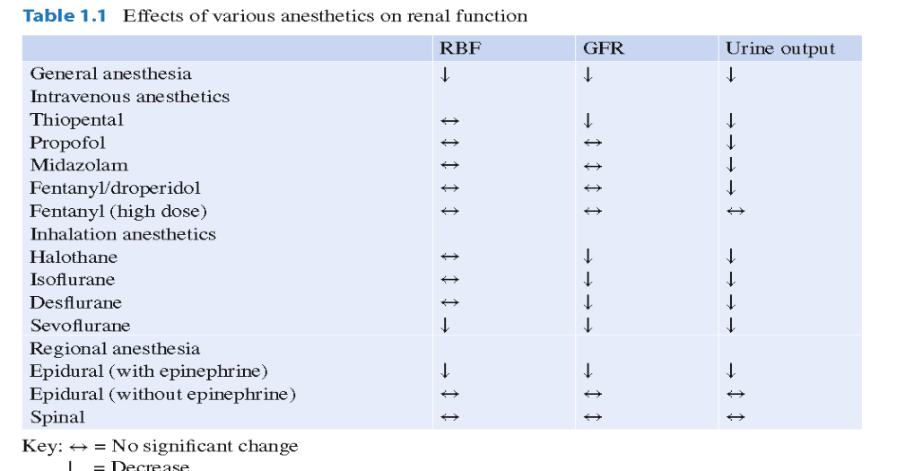

Slide 30
Thank you

